Slide 1
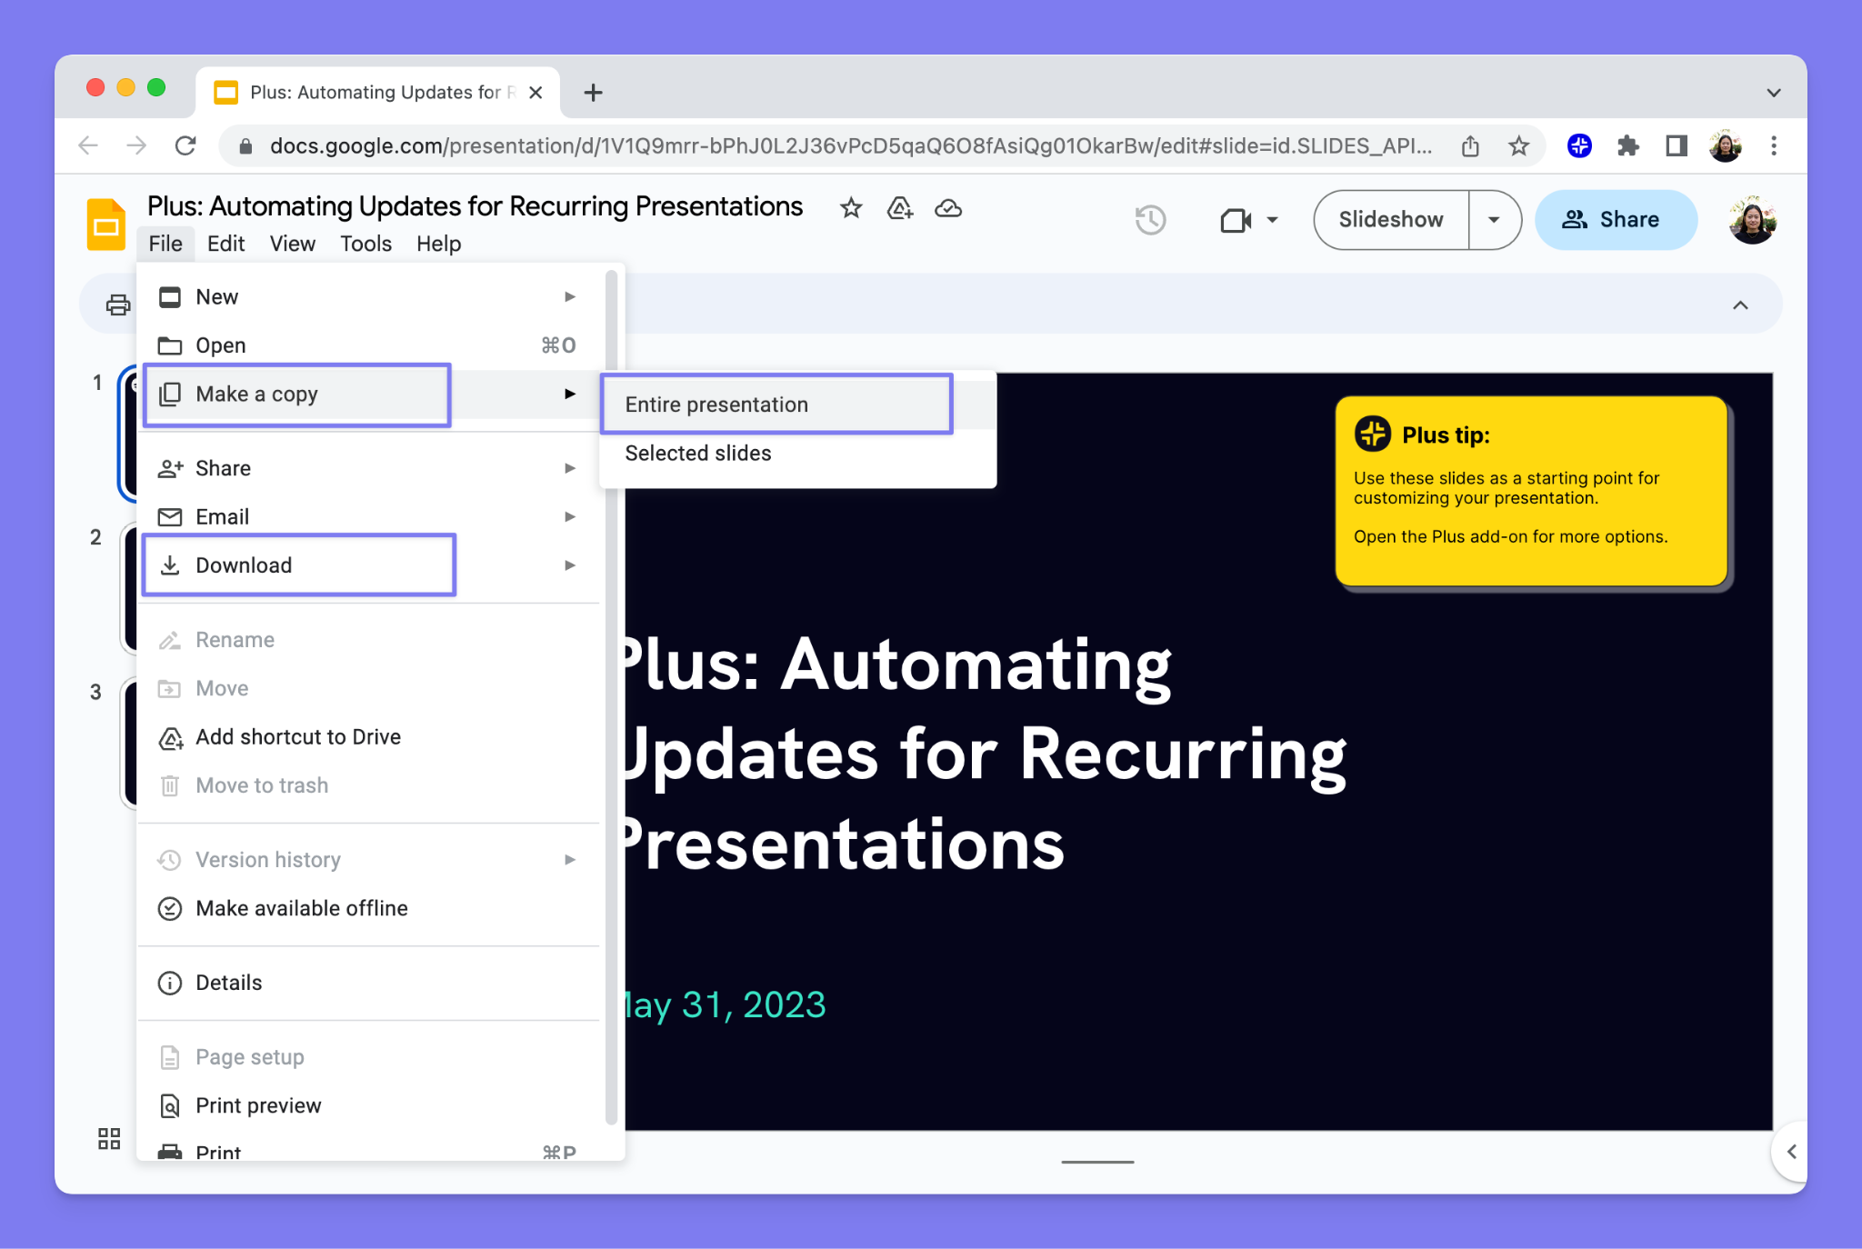
README
How to use this presentation
1
2
3
Make a copy of this presentation!
File > Make a copy > Entire presentation
⚠️This document will be deleted in 30 days.
Customize and use it however you’d like
Once you make a copy, you can edit this just like any other Google Slides presentation.
You can also download the presentation as a PowerPoint and PDF, and more.
Try Plus AI for free
Get the Plus AI extensions to generate and edit presentations directly in Google Slides and PowerPoint.
Learn more and start your free trial at plusdocs.com
Sign up for Plus AI to generate slides without the watermark.

Slide 2
Scala for ETL: Key Concepts
October 6, 2025

Slide 3
Agenda
Immutable vs Mutable Collections
Higher-Order Functions (HOFs)
Currying and Partial Functions
For-Comprehensions
Anonymous and Lambda Functions
Implicits and Type Parameters
Object-Oriented Scala
Companion Objects and Apply Methods
Best Practices for ETL
Working with Files (Scala I/O)
Integration with JSON, CSV, Config Files
Futures and Parallel Collections
Summary Table

Slide 4




Immutable vs Mutable Collections
Collections
Immutable Collections
Mutable Collections
Cannot be changed after creation; any modification results in a new collection. Examples: List, Vector, Map, Set from scala.collection.immutable.
Can be updated in place allowing in-place modifications. Examples: ArrayBuffer, ListBuffer, HashMap, Set from scala.collection.mutable.
Type & Packages
ETL Context
Immutable collections are default in Scala under scala.collection.immutable. Mutable collections are in scala.collection.mutable package.
Immutable collections are safer for parallel transformations like Spark RDDs. Mutable collections are useful for local buffering before writing output files.

Slide 5

Immutable vs Mutable Collections: Example
Collections
Scala Code Example and Output
Immutable List example: Original list remains unchanged when adding an element, creating a new list.
Mutable ListBuffer example: The collection updates in place when an element is added.
Output shows original immutable list and new list, plus modified mutable ListBuffer with added element.
Highlights the difference in behavior critical for safe parallel ETL processing vs local buffering.

Slide 6



Higher-Order Functions (HOFs)
Functions
Definition
Higher-Order Functions are functions that take other functions as arguments or return them as results, allowing flexible and reusable code.
Scala Example
def processList(nums: List[Int], func: Int => Int): List[Int] = nums.map(func) // Applies func to each element
val doubled = processList(List(1,2,3,4,5), x => x * 2) // Result: List(2,4,6,8,10)
Scala Example
HOFs are fundamental in Spark transformations like .map(), .filter(), and .reduce(), enabling concise and efficient data processing pipelines.

Slide 7




Currying and Partial Functions
Functions
Currying Explained
Currying Example
Currying transforms a multi-argument function into a sequence of single-argument functions, enabling partial application and reusability.
def multiply(x: Int)(y: Int): Int = x * y
val timesTwo = multiply(2)_
println(timesTwo(10)) // Output: 20
Partial Functions
Partial Function Example
Partial functions define behavior only for specific inputs, providing controlled handling of exceptional cases.
val divide: PartialFunction[Int, Int] = { case x if x != 0 => 100 / x }
if (divide.isDefinedAt(0)) println(divide(0)) else println("Division by zero not allowed")

Slide 8


For-Comprehensions
Comprehensions
Readable Syntax for Chaining
Example Usage
ETL Context
For-comprehensions simplify complex data transformations by chaining map, flatMap, and filter in a clean, readable way, replacing nested calls.
Using a for-comprehension, we filter a list to values greater than 15 and then transform each by dividing by 10, returning a new list.
For-comprehensions are ideal for transforming hierarchical or filtered data flows in ETL pipelines, making code easier to maintain and understand.

Slide 9


Anonymous and Lambda Functions
Functions
What are Anonymous Functions?
Anonymous functions, also known as lambda functions, are unnamed functions defined inline without explicit names, ideal for short, simple operations.
Scala Lambda Syntax
In Scala, lambdas are defined using syntax like x => x * x or using placeholder syntax such as _ * _ for concise expression of operations.
Scala Lambda Syntax
Widely used in Spark transformations such as .map() and .filter() for inline data transformations, enhancing readability and performance in ETL pipelines.

Slide 10


Implicits and Type Parameters
Generics & Implicits
Implicits
Type Parameters (Generics)
Implicits allow automatic passing of values or conversions without explicit mention, simplifying code especially for configuration injection in ETL pipelines.
Generics enable defining classes or methods that work with any data type, enhancing reusability and type safety in ETL data processors.
Example: Implicit Parameter
Example: Generic Method
An implicit tax rate is used in a function to calculate totals without explicitly passing the tax each time, streamlining financial calculations.
A generic printList method prints elements of any list type, demonstrating how generics make ETL components adaptable to various data types.

Slide 11

Object-Oriented Scala
OOP
Classes and Traits
Inheritance
ETL Context
Classes define blueprints for ETL jobs; traits provide reusable behavior like logging or configuration that can be mixed in.
Inheritance allows ETL job classes to extend traits or other classes, enabling code reuse and easy extension of functionality.
Use classes and traits to modularize ETL steps, such as defining job types with shared logging or configuration logic for maintainability.

Slide 12
Companion Objects and Apply Methods
Companion
A companion object in Scala shares the same name as a class and can access its private members. It acts as a factory for creating instances.
The apply method inside the companion object lets you create objects without using the 'new' keyword explicitly.
Example:
class Config private(val url: String, val port: Int)
object Config {
def apply(url: String, port: Int): Config = new Config(url, port)
}
val conf = Config("localhost", 8080) // calls apply method
This pattern simplifies object creation and is useful for managing ETL configurations or resources.

Slide 13




Best Practices: Functional Programming for ETL
Best Practices
Avoid Mutable State
Use Pure Functions
Leverage Immutability
Using immutable data structures prevents side effects and ensures thread-safety in parallel ETL jobs, reducing bugs.
Functions should produce outputs solely based on inputs without side effects, making ETL transformations predictable.
Immutable collections prevent unintended changes during ETL workflows, improving reliability in distributed processing.
Prefer Map, Filter, Reduce
Use Option, Try, Either
Favor Declarative Style
Use declarative transformations instead of loops for cleaner, more maintainable ETL code.
Handle missing or erroneous data gracefully to avoid runtime failures in ETL pipelines.
Write ETL code that expresses what to do, not how, increasing readability and ease of maintenance.

Slide 14

Working with Files (Scala I/O)
File I/O
Reading and Writing Large Files in Scala
Use scala.io.Source to read files line-by-line efficiently, handling large files with minimal memory overhead.
Use java.io.PrintWriter to write processed data to files, supporting transformations like converting text to uppercase.
Always close file resources after operations to prevent resource leaks.
This approach is ideal for batch ETL processes involving raw file ingestion and output generation.

Slide 15
Integration with JSON, CSV, and Config Files
Data Integration
JSON Integration with json4s
CSV Integration with scala-csv
json4s provides easy parsing and extraction of JSON data.
Supports automatic conversion to Scala case classes using implicit formats.
Example: parse JSON string and extract "name" field.
Widely used for ingesting JSON in ETL workflows.
scala-csv simplifies reading and writing CSV files with headers.
Allows iteration over rows and easy access to columns by name.
Example: read CSV file and print rows with headers.
Commonly used for processing tabular data in ETL jobs.

Slide 16




Futures and Parallel Collections
Concurrency
Futures
Parallel Collections
Futures represent asynchronous computations allowing non-blocking ETL operations, enabling tasks like data loading and transformation to run concurrently.
Parallel collections enable easy data parallelism by splitting collections across multiple cores for concurrent processing, improving ETL throughput.
Futures Example
Parallel Collections Example
Using Futures, ETL tasks like loading and transforming data can run concurrently and combine results without blocking the main thread.
Parallel collections allow operations like map and reduce to be executed in parallel on collections, speeding up ETL data transformations.

Slide 17
Summary Table
Summary
Immutable vs Mutable
Higher-Order Functions
Currying & Partial Functions
Immutable collections are thread-safe and preferred for Spark transformations; mutable collections offer in-place updates for efficient local buffering.
Functions as first-class citizens enable expressive transformations like map, filter, and reduce on datasets.
Facilitate reusable parameterized functions and graceful handling of invalid inputs in ETL workflows.
For-Comprehensions
Implicits & Generics
Futures & Parallel Collections
Provide a clear, readable syntax for chaining transformations and filtering hierarchical data.
Implicits simplify configuration injection; generics enable reusable, type-safe data processors.
Support concurrency and parallelism for efficient ETL processing and faster data operations.

Slide 18
Thank you

